Slide 1
What do you know about…?
…the Zapatistas of Chiapas, Mexico?
…Mayan autonomy?
…indigenous education?
A PowerPoint presentation accompanying the short teaching video entitled “An Introduction to Zapatista Education”
http://www.schoolsforchiapas.org/teach-chiapas/teach-chiapas-video-series/

Slide 2
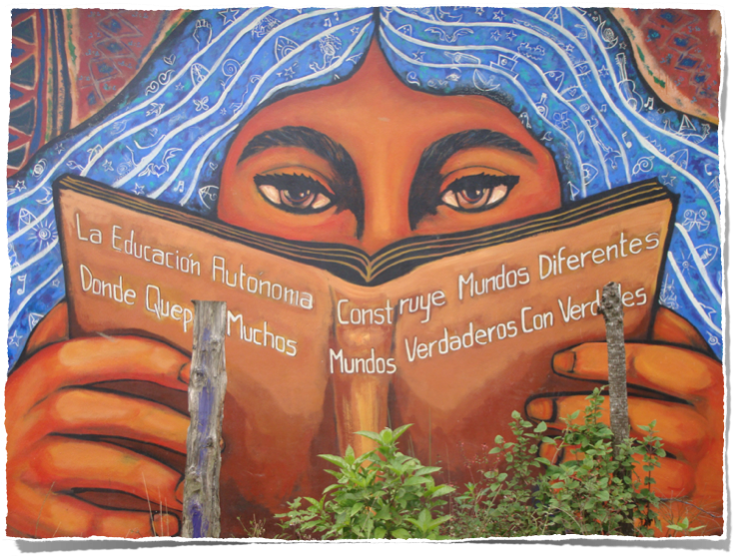
Zapatista Autonomous Education in Chiapas, Mexico
A PowerPoint presentation accompanying the short teaching video entitled
“An Introduction to Zapatista Education”
http://www.schoolsforchiapas.org/teach-chiapas/teach-chiapas-video-series/

Slide 3
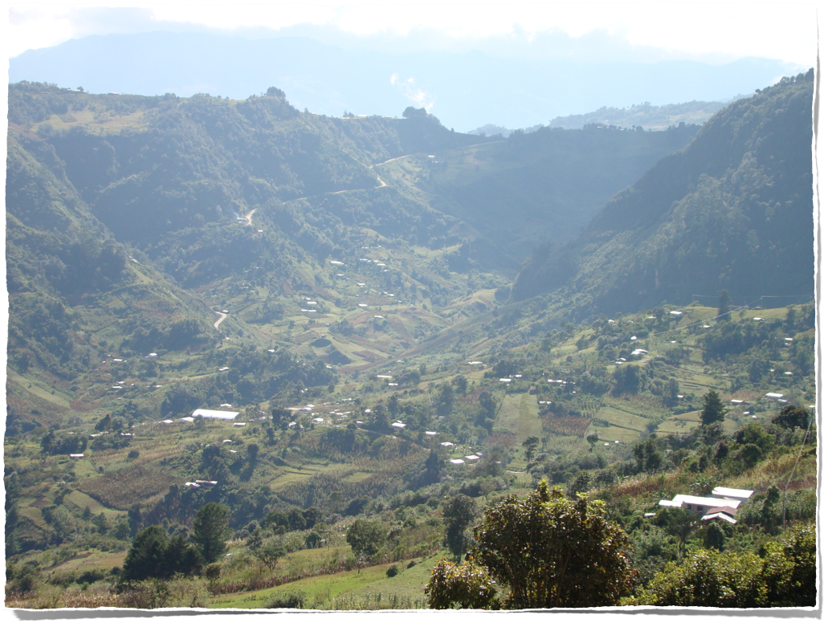

Slide 4
Why Autonomous Education?
“For our children there are no schools or medicines, no clothes or food, not even a dignified roof under which we can store our poverty … For our boys and girls there is only work, ignorance and death … Our children have to begin work at a very young age … our children’s toys are the hoe, the machete, and the axe; when they are barely able to walk, playing and suffering, they go out looking for firewood, clearing brush and planting …They cannot go to school to learn Spanish because work kills the days and sickness kills the nights. This is how our children have lived and died for 501 years”.

Slide 5
Why Autonomous Education?
In Mexico, 16 million people consider themselves indigenous.
7,700,000 of those people speak an indigenous language.
95% only speak their language at home. Only 45% speak it at official schools.
28% of the population of Chiapas speak an indigenous language.

Slide 6
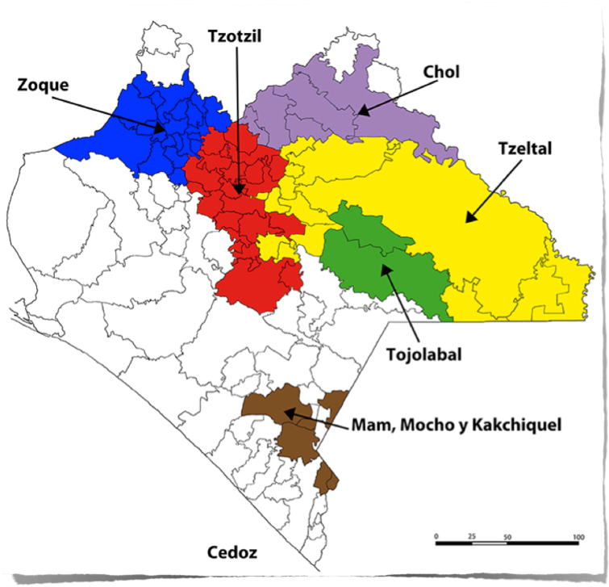

Slide 7
Why Autonomous Education?
Chiapas has the highest rate of illiteracy in Mexico standing at 18%.
It has the lowest percentage of people 6-14 at school.
The average level of schooling for 15-year-olds is 7th grade.
Failures of ‘official’ school system.
UN right of indigenous peoples to determine their own education systems.

Slide 8
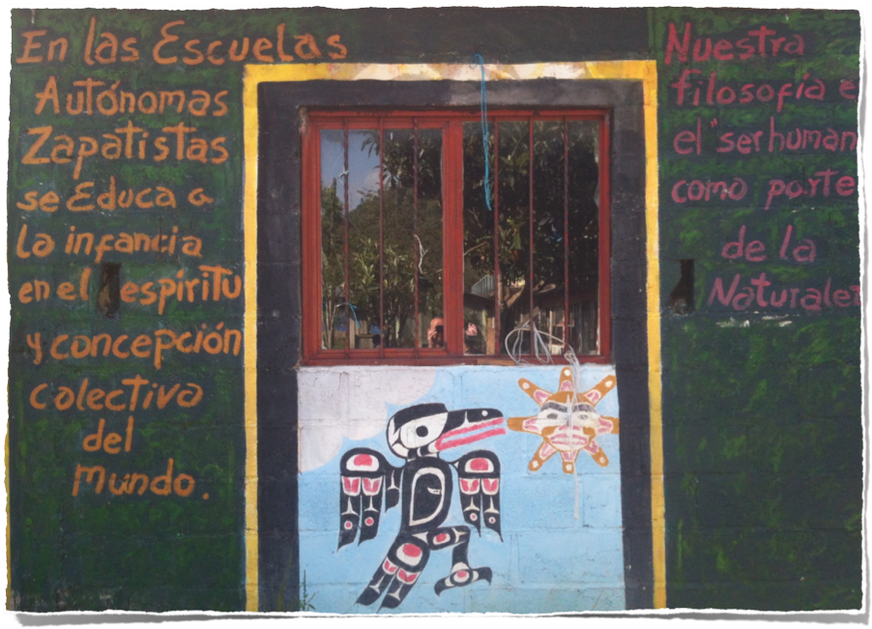
Opening doors to alternatives

Slide 9
What are the Characteristics of Autonomous Education?
Organised within and by the self-governing ‘caracoles’.
Use of ‘education promoters’.
Emergent approach to education.
Focus on culture and language of the learners.

Slide 10
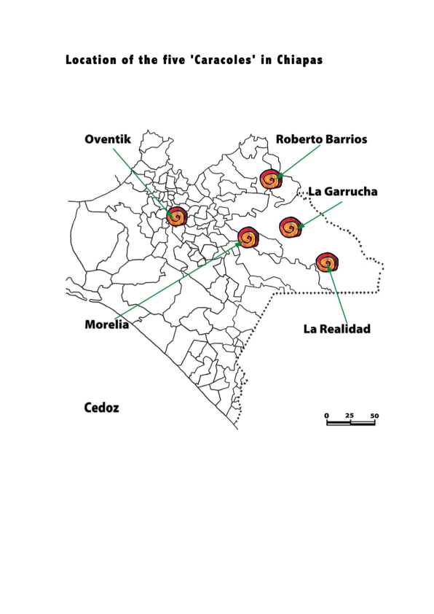

Slide 11
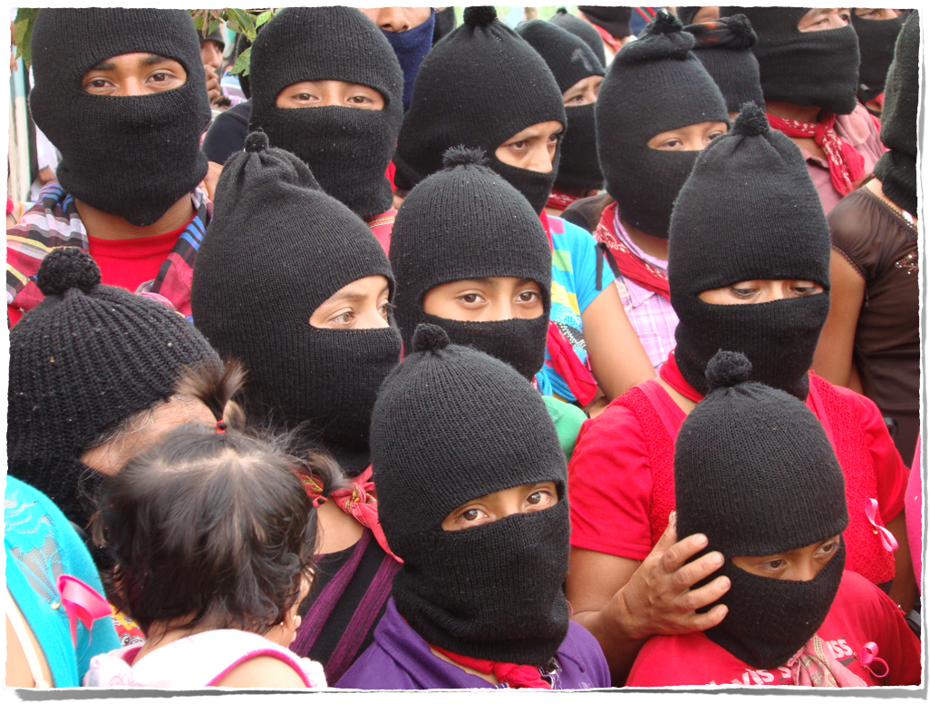

Slide 12
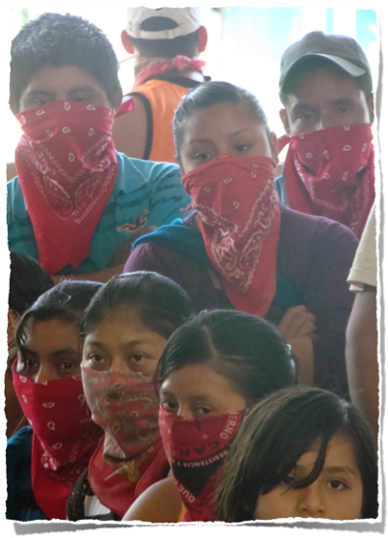
Who are the Zapatista education promoters and how are they selected?
Selected from and by their own communities.
Work as unpaid volunteers in service to the community.
Supported with food and housing by the community.

Slide 13
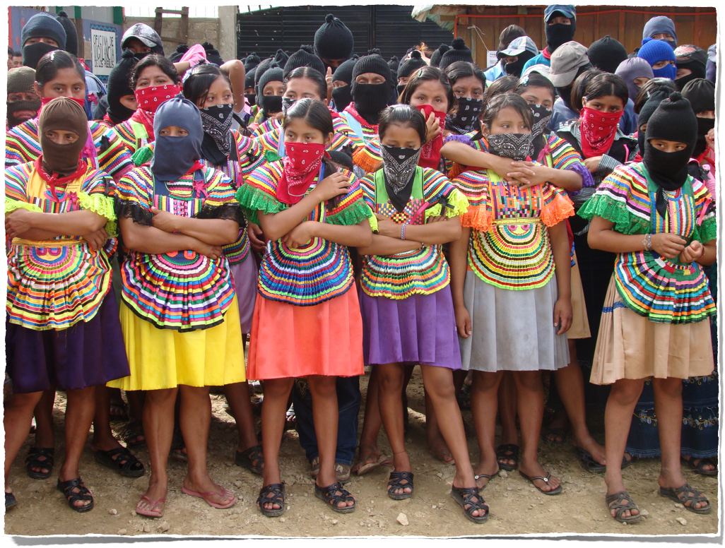

Slide 14
What’s taught in the autonomous schools?
Language and literacy.
Math and numeracy.
Life and environment.
History.
Culture and arts.
Sports.

Slide 15
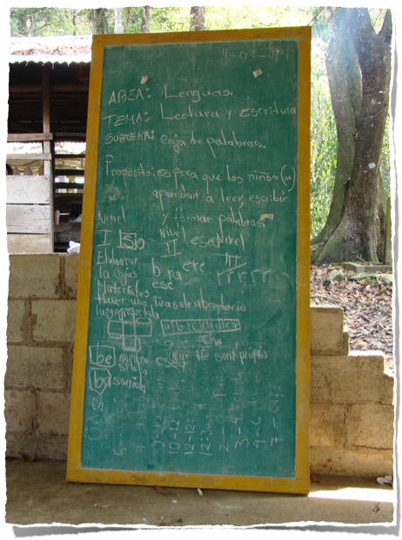
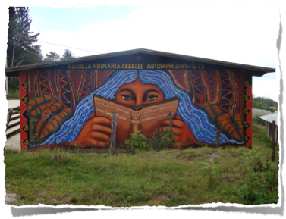
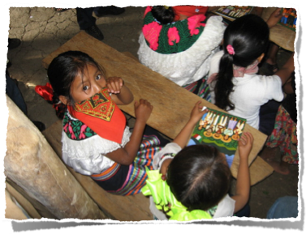
Education

Slide 16
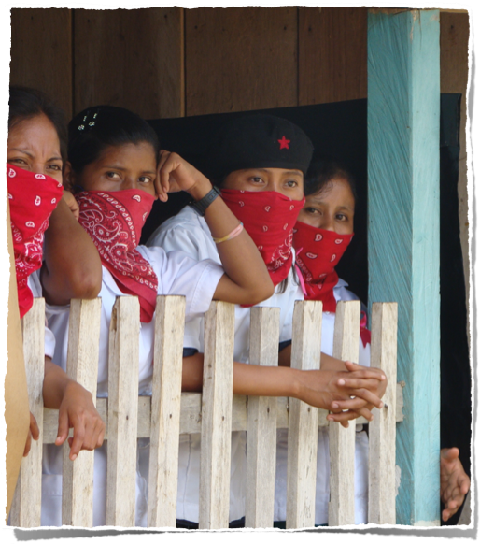
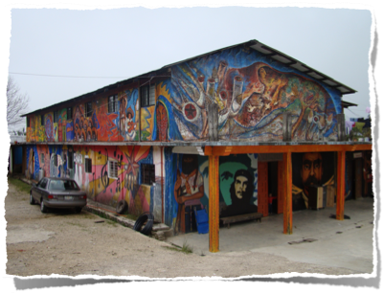
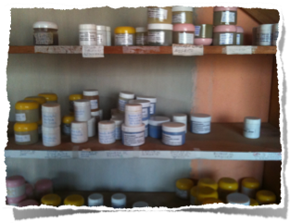
Health

Slide 17
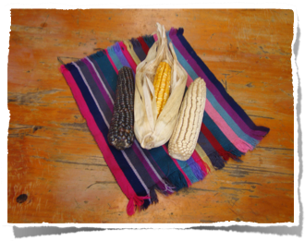
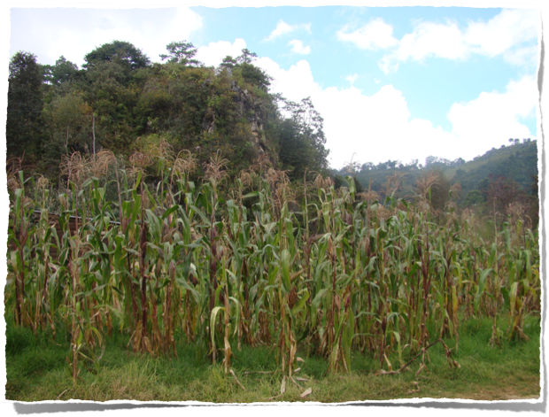
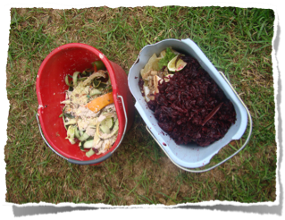
Agroecology

Slide 18
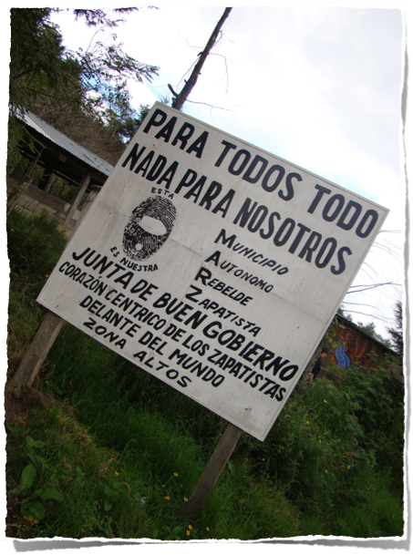
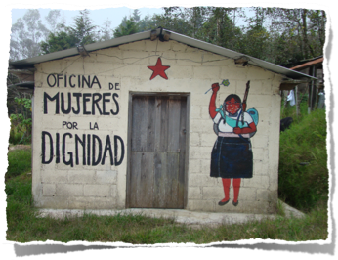
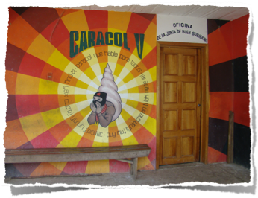
Government

Slide 19
“Antonio dreams that the land he works belongs to him. He dreams that his sweat earns him justice and truth; he dreams of schools to cure ignorance and medicines to frighten death. He dreams that his house has light and that his table is full; he dreams that the land is free and that his people reasonably govern themselves. He dreams that he is at peace with himself and with the world. He dreams that he has to struggle to have this dream…”
from ‘Chiapas: The Southeast in Two Winds – A Storm and a Prophecy’

Slide 20
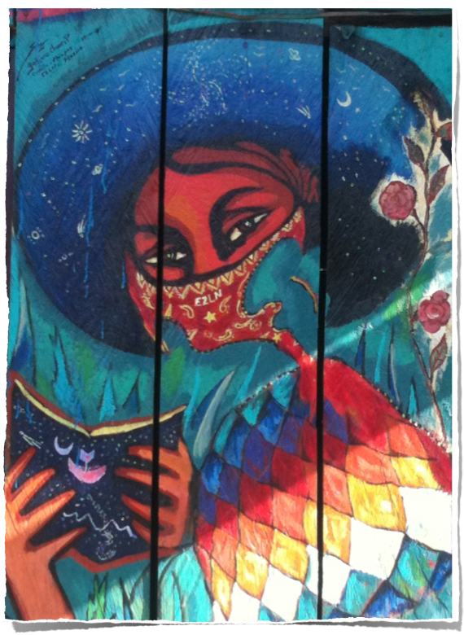

Slide 21
So…what can you do?
Find out more about the Zapatistas at places like our web page: www.schoolsforchiapas.org
Begin a project to provide support for the autonomous communities in Chiapas, Mexico.
Subscribe to our newsletter and follow us on Facebook & Twitter.
Organize efforts where you live to build a more just, democractic, and dignified world!

